Slide 1
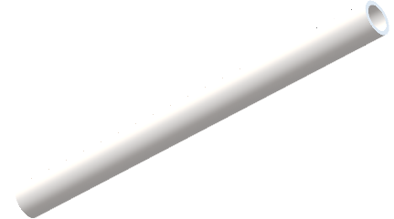
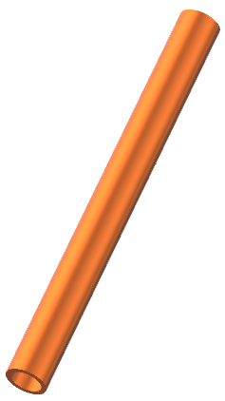
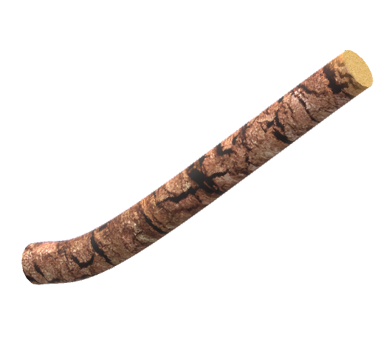
Conductor survey
Some materials are good thermal conductors.
Some materials are insulators.
Thermal conductors Thermal insulators
bubble wrap

Slide 2
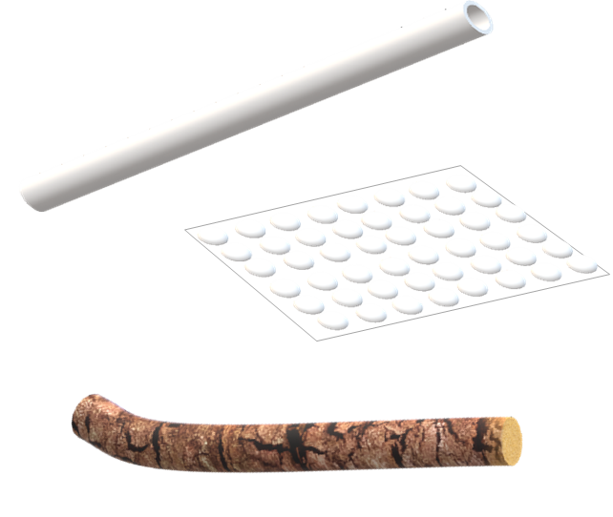
Conductor survey
What do you think about good conductors and insulators?
I am sure this is right
I think this is right
I think this is wrong
I am sure this is wrong
A
Metals are good thermal conductors
B
Trapped air is a good insulator
C
Insulators have a higher temperature than good conductors
D
Insulators can help to keep things cold
E
Energy moves quickly through a conductor by heating

